Slide 1
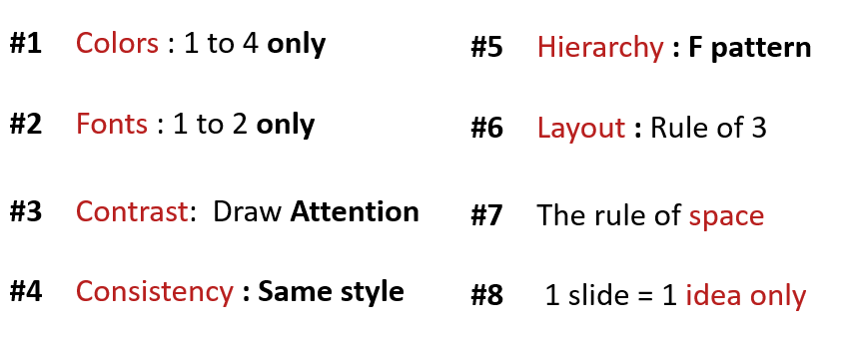
ACTIVITY 1
Analyze the 3 slides
Why they respect the design principle?

Slide 2
Computer / Database Diagram
Marketing is the study and management of exchange relationships. Marketing is the business process of creating relationships with and satisfying customers.
Analyze
Promotions only work as well as the marketing, to get your company’s.
+35
To get your company’s name out there.
Advertise
Promotions only work as well as the marketing, to get your company’s.
+10
To get your company’s name out there.
Identify
Promotions only work as well as the marketing, to get your company’s.

Slide 3
Comparison Chart
Marketing is the study and management of exchange relationships. Marketing is the business process of creating relationships with and satisfying customers.
Develop
Analyze
Promotions only work as well as the marketing. Promotions only work as well as the marketing.
vs.
Promotions only work as well as the marketing. Promotions only work as well as the marketing.
Promotions only work as well as the marketing.
Promotions only work as well as the marketing.
DEVELOP
DEVELOP
ANALYZE
ANALYZE
Promotions only work as well as the marketing.
Promotions only work as well as the marketing.
IDENTIFY
IDENTIFY

Slide 4
Title One
Promotions only work
as well as the marketing.
Title Two
Promotions only work
as well as the marketing.
Business
Infographics
Title Three
Promotions only work
as well as the marketing.
Marketing is the study and management
of exchange relationships.
Title Four
Promotions only work
as well as the marketing.
Title Five
Promotions only work
as well as the marketing.

Slide 5
Why they respected the design principle?
analysis
Color | Color maximum only 4
font | Only 2 font (Lato with title,heading, content and Lato light with the paragraph)
consistency | Every slide is the same style (font, color, icons, space)
layout | Respected to the rule of 3x3 grid (layout of the icon and paragraph fixed properly)
space | It has space between the paragraph and each element
1 slide | Only 1 idea
Heirarchy | Identify what that they want you to see first
contrast | Contrast with font size and color of the icons

